Slide 1
Angular Component Trees
Peter Eijgermans peter.eijgermans@ordina.nl

Slide 2
Angular-app = Tree of components
<todo-app>
<todos-list>
<todo-item>
<todo-item>
{{ todo-text}}
{{ todo-text}}
{{ todo-checked}}
{{ todo-checked}}

Slide 3
Angular-app = Tree of components
Steps to create Multiple child components?
Create a separate Child Component
Define this component in the app.module.ts
Add this component in the HTML of the parent-component
Repeat these steps for all other child components

Slide 4
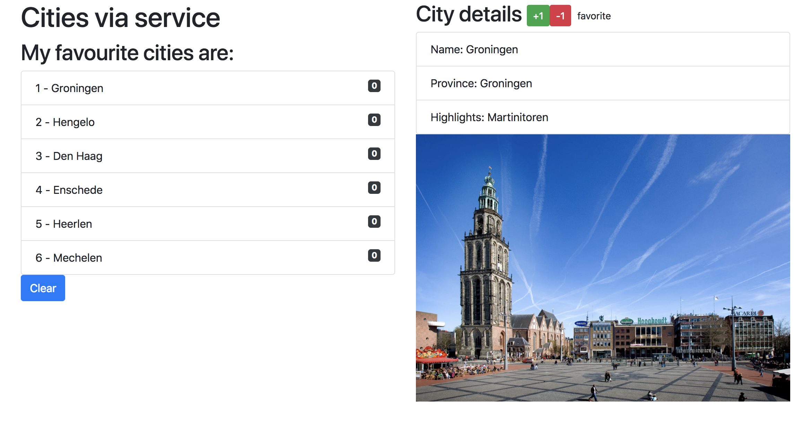

Slide 5
Component based
SideBarComponent
AppModule
AppComponent
CityListComponent
CityDetailComponent
Notes:
Angular apps are composed of modules.
Modules exports classes, function, values — that other modules import.

Slide 6
Component based A component adds logic to DOM elements Angular app consist of a treestructuur of components
main.ts
AppModule
AppComponent
app.component.html
CityListComponent
CityDetailComponent
city-detail.component.html
Notes:
Angular is a tree of components, because it has the same structure as your html-structure !!!
Index.html is the parent template of AppComponent ect…
AppComponent is the parent of BookComponent and …
main.ts

Slide 7
1. Create a separate City-detail component
// city.detail.ts
import { Component } from '@angular/core';
@Component({
selector: 'city‐detail', template: `
<h2>City details</h2>
<ul class="list‐group">
Nieuwe selector
Nog in te vullen
<li class="list‐group‐item">Naam: [naam van stad]</li>
<li class="list‐group‐item">Provincie: [provincie]</li>
<li class="list‐group‐item">Highlights: [highlights]</li>
</ul>
`
})
export class CityDetail{
}

Slide 8
2. Define this component in the app.module.ts
// app.module.ts
…
import {CityDetail} from "./city.detail"; // Nieuwe component invoegen
@ngModule({
…
declarations: […,CityDetail]
})
// Niet vergeten: invoegen bij declarations!
export class AppModule {
…
}

Slide 9
3. Add this component in the HTML of the parent-component
<!‐‐ app.html ‐‐>
<div class="row">
…
<div class="col‐md‐6">
…
<city‐detail></city‐detail>
</div>
</div>
Combineren met overige HTML

Slide 10
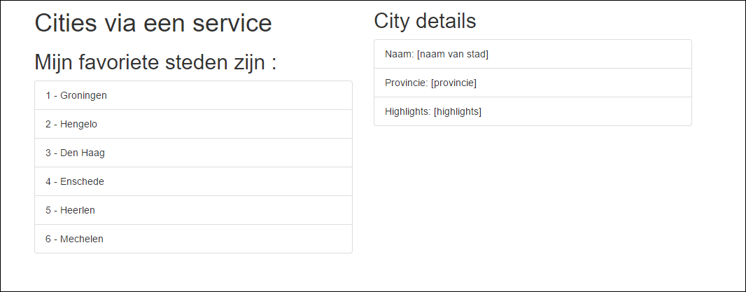
4. Result
To Do

Slide 11
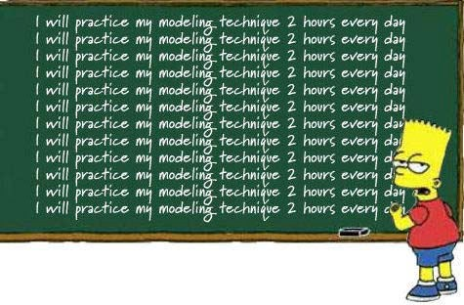
Checkpoint
See: 6a + 6b
Oefening….

Slide 12
Data flow between components
Use inputs and outputs

Slide 13
Data flow between components
“Data flows to a component via
@Input() ‘s”
Data flows out of a component via
@Output()’s”

Slide 14
@Input

Slide 15
Parent-Child flow: use annotation @Input()
<city-app>
[city]=“currentCity”
…
@Input() city: City
<city-detail>
{{ city.name}}
{{ city.province}}

Slide 16
Use @Input() in ChildComponent
Import the Input service in the component
Use the Annotation @Input() in the class definition
// city.detail.ts
import { Component, Input } from '@angular/core'; import { City } from "./city.model";
@Component({
…
})
Input
export class CityDetailComponent {
@Input() city: City;
}

Slide 17
Change the Parent HTML for @Input
<!‐‐ app.html ‐‐>
<div class="row">
<div class="col‐md‐6">
…
<ul class="list‐group">
<li *ngFor="let city of cities" class="list‐group‐item" (click)="getCity(city)">
{{ city.id}} ‐ {{ city.name }}
</li>
</ul>
</div>
<div *ngIf="currentCity">
<city‐detail [city]="currentCity"></city‐detail>
</div>
</div>
</div>
Aanpassing
Change!

Slide 18
Change the Parent Component Class
export class AppComponent {
// Properties voor de component/class
public cities:City[];
public currentCity:City;
… getCity(city) {
this.currentCity = city;
}
…
}

Slide 19
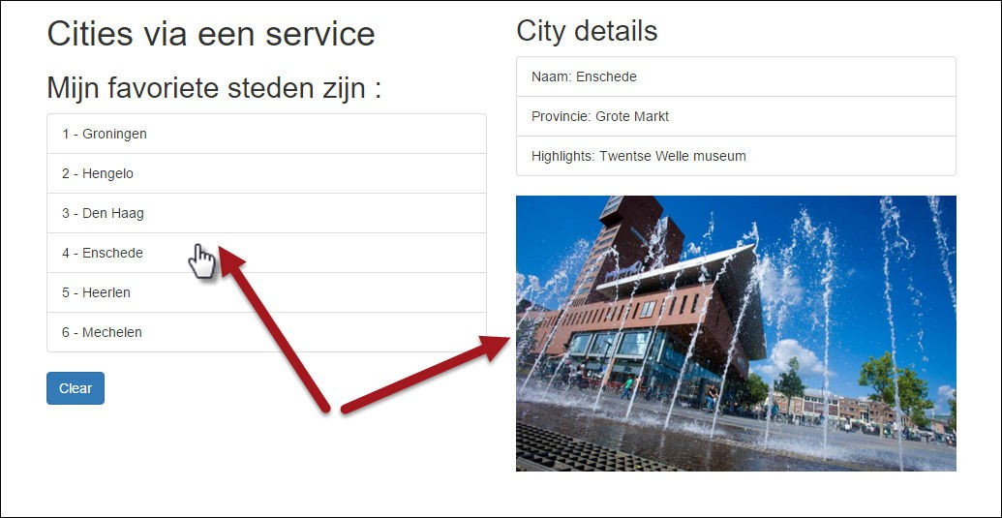
Result

Slide 20
Checkpoint
Data flow to Child Component : Use @Input() and
[propName]=“data”
See: 6c
Exercise….

Slide 21
@Output

Slide 22
Child-Parent flow: use annotation @Output()
<city-app>
(event)=“myEvent($event)”
…
@Output() event: EventEmitter<Type>
<city-detail>
{{ city.name}}
{{ city.province}}
P.165

Slide 24
Steps to take
Import Service Output in the CityDetailcomponent
Use annotation @Output() in de class definition
3. Define EventEmitter and the Type Annotation
“With @Output,
data flows up the Component Chain”
18

Slide 25
Give rating to Cities
// city.detail.ts
import { Component, Input, Output, EventEmitter} from ’@angular/core';
@Component({
… template: `
<h2>City details
<button (click)="rate(1)">+1</button>
<button (click)="rate(‐1)">‐1</button>
</h2>
…
`
})
Imports
Bind custom events to DOM
export class CityDetail {
@Input() city:City;
@Output() rating: EventEmitter<number> = new EventEmitter<number>();
Define & handle
public rate(num) {
console.log('rating voor ', this.city.name, ': ', num); this.rating.emit(num);
}
custom
@Output event
}

Slide 26
Prepare Parent Component to receive custom event
<!‐‐ app.html ‐‐>
<div *ngIf="currentCity">
<city‐detail [city]="currentCity" (rating)="updateRating($event)">
</city‐detail>
</div>
// app.component.ts
// increase or decrease rating on Event Emitted
updateRating(rating){
this.currentCity.rating += rating;
}

Slide 27
Show Rating in the HTML of the Parent
<li *ngFor="let city of cities" class="list‐group‐item" (click)="getCity(city)">
{{ city.id}} ‐ {{ city.name }} ({{i}})
<span class="badge">{{city.rating}}</span>
</li>
Rating

Slide 28
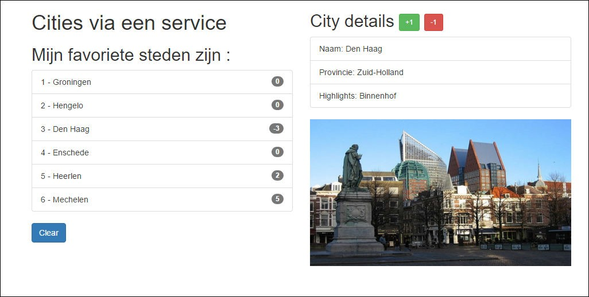
Result

Slide 29
Summary
Parent → Child
Child → Parent
<app>
<app>
[city]=“someCity”
(rate)=“onRate()”
<city-list>
<city-list>
[city]=“someCity”
(rate)=“onRate()”
<city-detail>
<city-detail>

Slide 30
Checkpoint
Data flow to Parent Component : use @Output() and
(eventName)=“eventHandler($event)”
See 6d
Exercise….

Slide 31











Communication between siblings
via Output() van een childcompo andere childcompon
< >
ut() van
ent
parent
Handle someEvent, set someProperty
[someProperty]=“someProperty”
meEvent)=“someE
(so
vent()”
<child-
1>
<child-2>
emo: 12a-components-siblin
T-IT
D
gs
5HAR

Slide 32
Use Pub/Sub-systeem with Observables
“Custom events, use an event bus”

Slide 33
Event bus
Event
App
<component-1>
<component-4>
<component-2>
<component-3>
<component-5>
{{…}
}
{{…}
}
{{…}
}

Slide 34
Use Subject
Notes:
A Subject is a special type of Observable that observers can also subscribe to it to receive published values but with one difference: The values are multicasted to many Observers.
Subjects are also Observers i.e they can also subscribe to other Observables and listen to published data.
By default an RxJS Observable is unicast.
Unicast simply means that each subscribed observer has an independent execution of the Observable while multicast means that the Observable execution is shared by multiple Observers.

Slide 35
Use Subject
Subject() = Observable and Observer
“Publish en Subscribe” – PubSub systeem

Slide 36
<city-list>
<city-details>
Book now!
publish
Event
<city-orders>
subscribe

Slide 37
PubSub-service maken
Step 1 – Make a Publication service
Step 2 – Create ‘Producer’ or ‘Publish’ – component
Step 3 – Create Subscriber-component

Slide 38
1. OrderService
// order.service.ts
import {Subject} from "rxjs/Subject"; import {Injectable} from "@angular/core"; import {City} from "../model/city.model";
@Injectable()
export class OrderService { stream:Subject<City>;
constructor() {
this.stream = new Subject<City>();
}
}

Slide 39
2. Producer component (‘book now’- button)
In de HTML:
<h2>Prijs voor een weekendje weg:
{{ city.price | currency:'EUR':true:'1.2' }}
<button class="btn btn‐lg btn‐info" (click)="order(city)">Book now!</button>
</h2>
In de class:
// Order plaatsen. Event emitten voor deze stad.
// Dit gaan opvangen in city.orders.ts
public order(city) {
console.log(`Stedentripje geboekt voor: ${this.city.name}); this.orderService.stream.next(city);
}

Slide 40
3. Subscriber component
//city.orders.ts ‐ Een soort 'winkelmandje',
// bijhouden welke stedentripjes zijn geboekt.
import …
@Component({
selector: 'city‐orders', template: `
<div *ngIf="currentOrders.length > 0">
…
})
export class CityOrdersComponent {
…
ngOnInit() {
this.orderService.stream
.subscribe(
(city:City) => this.processOrder(city), (err)=>console.log('Error bij verwerken City‐order'), ()=>console.log('Complete...')
)
}
` …
}

